Slide 1
ENSE 374, Milestone 4
Software Group B
Avery, Nick, Renz, Jinkai, Jiahao, Mckenzie
November 15, 2018

Slide 2
Lo-fi prototypes
Content Strategy
Main goal was consistency
Make navigation intuitive and quick
Make all primary pages accessible in one click from any page
Governance/security
Notes:
Nick
For our Lo-fi prototypes we had some key strategies for content that we developed in milestone 3.
Our main goal was consistency between the public site and the private intranet site. This was one of the asks from the administrative team and gave us an example to go off of to base our designs around.
As for navigation we wanted everything in as few clicks as possible while being categorized logically. We wanted to avoid any comments along the lines of “oh now I get it”, we wanted navigation to be intuitive with little learning curve
We also wanted to make sure that with one click you could make it back to any of the primary pages. Seeing as we don’t have too many levels of pages it makes it a quick way of going back without hitting the back button
For security, the user login will allow for verification against the individual user and their user/faculty groups, additional logins may be required for particularly sensitive or confidential files if possible or needed with Cascade Server.
Main parts of security selection are:
Who has access
what they have access to
Why they have access
We did a bit of looking at the Cascade Server and it is set up initially quite like the main site which will make it easier to keep it consistent between the two.

Slide 3
User questionnaire
Pre-Task Questions:
Position with the University?(Faculty, Administration, Dean’s Office)
How would you rate the currently live version of the site?
Post-Task Questions:
How would you rate the navigation to a course? or a staff member?
Could you find a needed form quickly?
If you got lost looking for something, how many times did you get lost?
Notes:
Nick
For our user questionnaire we are still coming up with pre-task questions, however each main section of content has some general or post task questions;
Some of our pre-task questions we came up with are :
What is your current position with the university? This is to help categorize how each group using the site think about it and if there are common things that administration likes that others may not for example.
We also want to get a general overview of how the current site is rated.
Another pretask question could be to ask about general appearance and initial thoughts before navigating through the site.
Our post task questions include: How would you rate navigation to a course or a specific staff member? Could you find a needed form quickly? This allows us to determine if navigation is intuitive and where to improve.

Slide 4
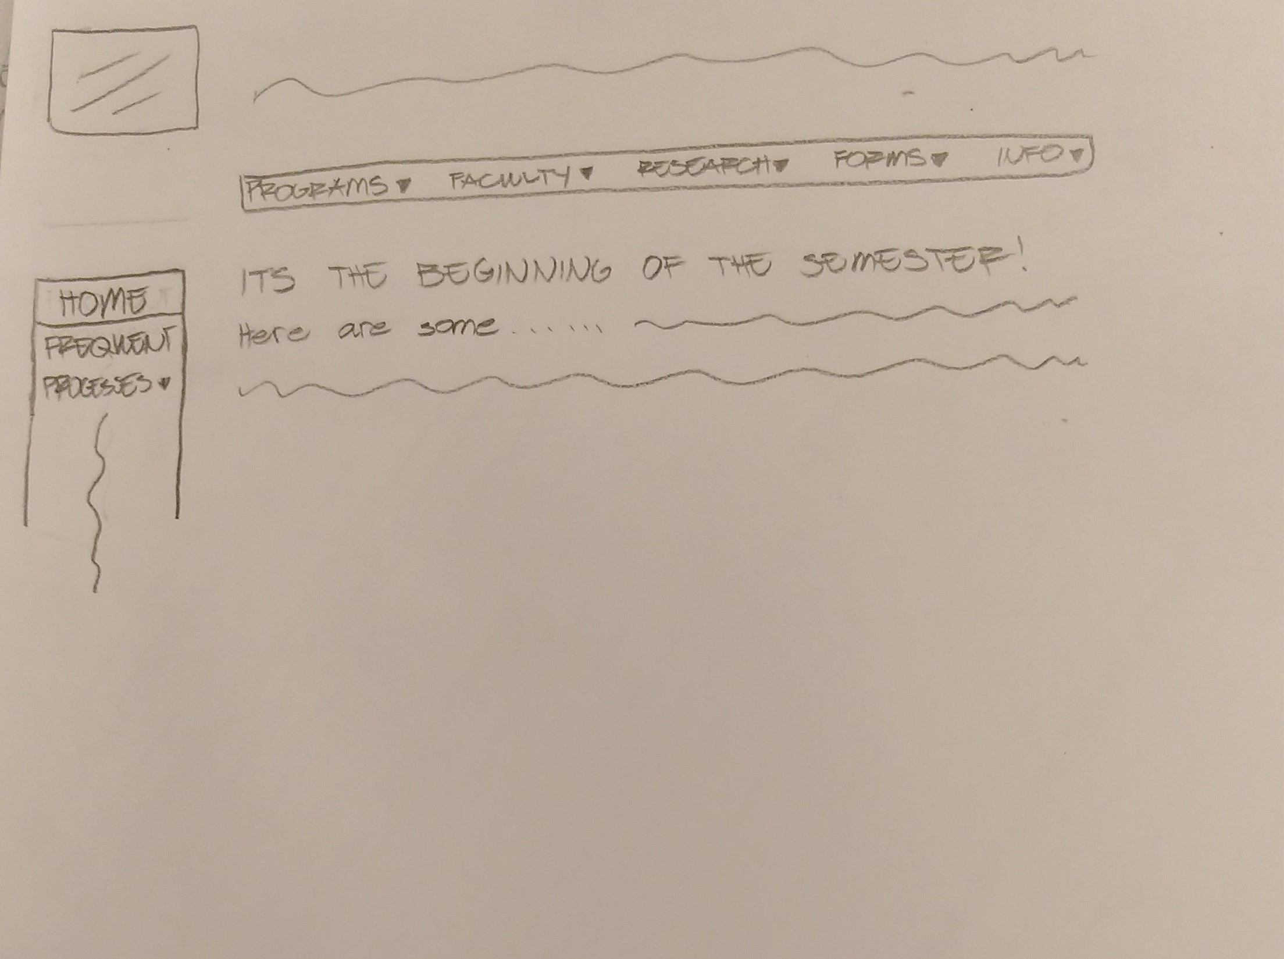
Homepage
Content:
Dynamic — provides quicker access to links that are necessary at a specific time of the semester
Frequently used processes
General Structure of the Pages:
The University of Regina logo along with the title “Faculty of Engineering”
The main navigation bar
A smaller listed version of the main content in a side navigation bar
Notes:
Renz
Content:
Dynamic — based on time period of the semester
The frequently used processes — could be a link to the contact information of different departments
Structure:
Consistent throughout all the pages
University of Regina logo along with the title “Faculty of Engineering”
Main navigation bar
Side navigation

Slide 5
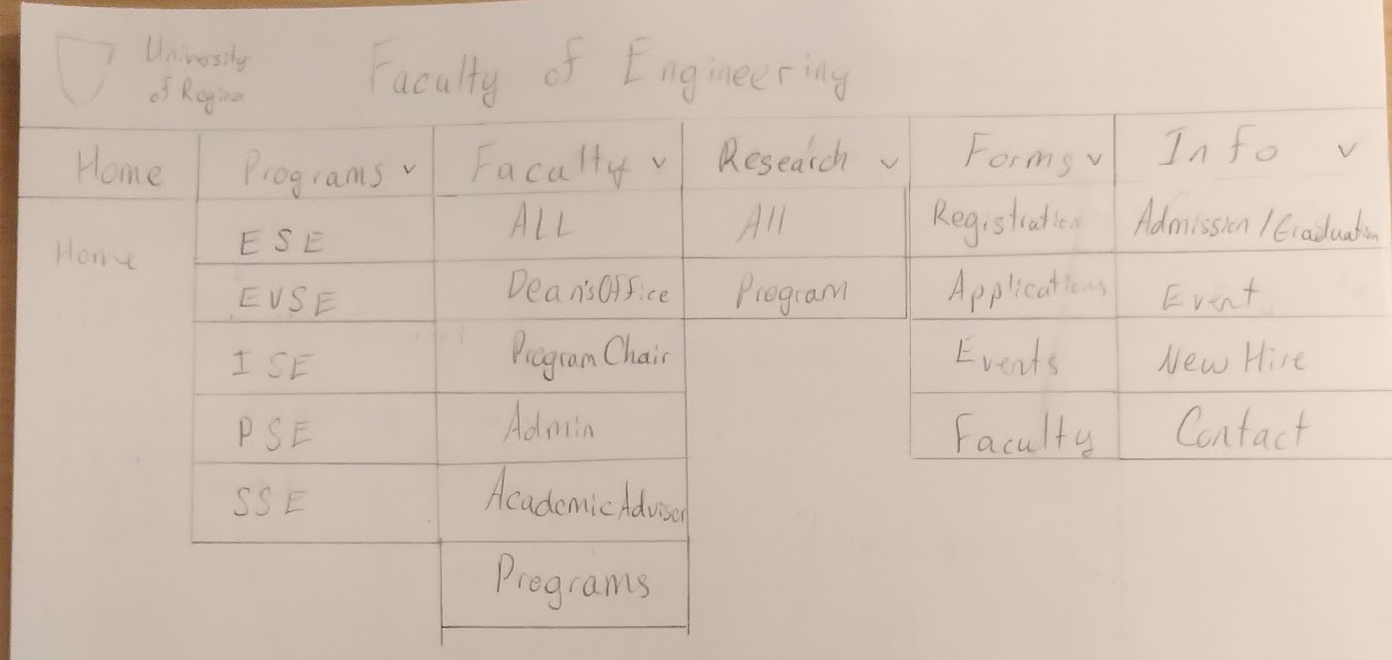
Homepage
General Workflow of the Pages:
Main access: the navigation bar
Quick access of the contents of a page: side navigation bar
Notes:
Renz
Navigation / Workflow:
The main access is the navigation bar — connects all the pages
The side navigation bar allows for quick access — could potentially ease the user’s experience by preventing them from scrolling through the page’s content
The homepage as a page itself does well with many tests we’ve had for it is dynamic and always strives to provide ease of use
Questions
How would you rate navigation using the drop down menus?

Slide 6
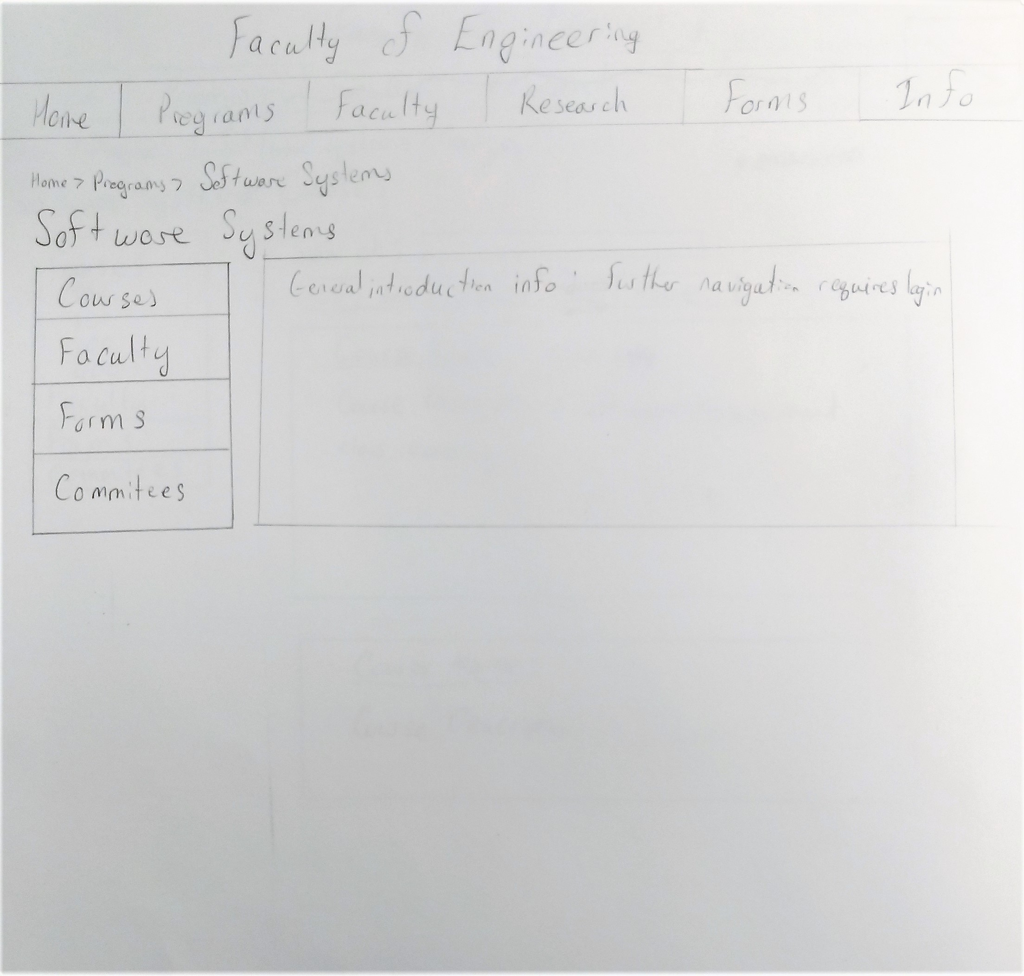
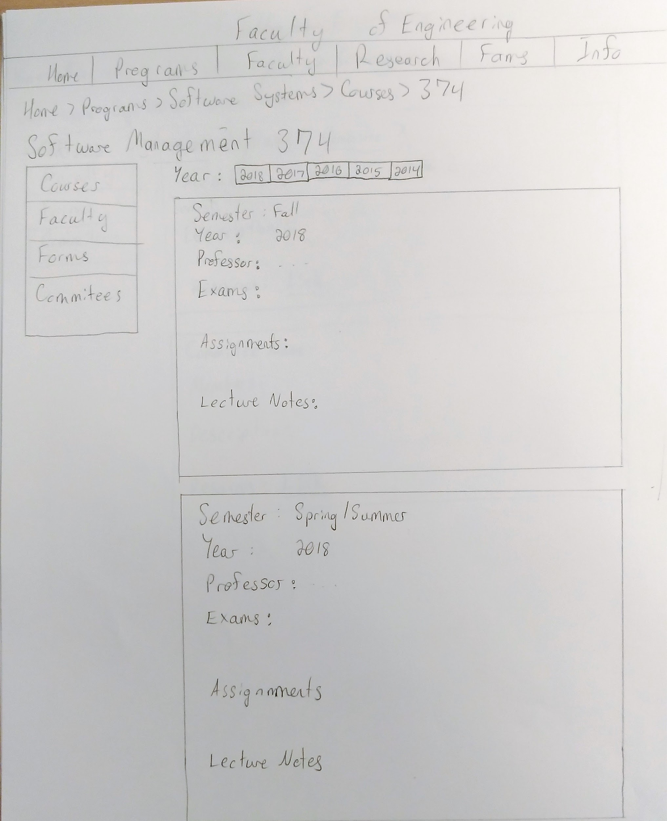
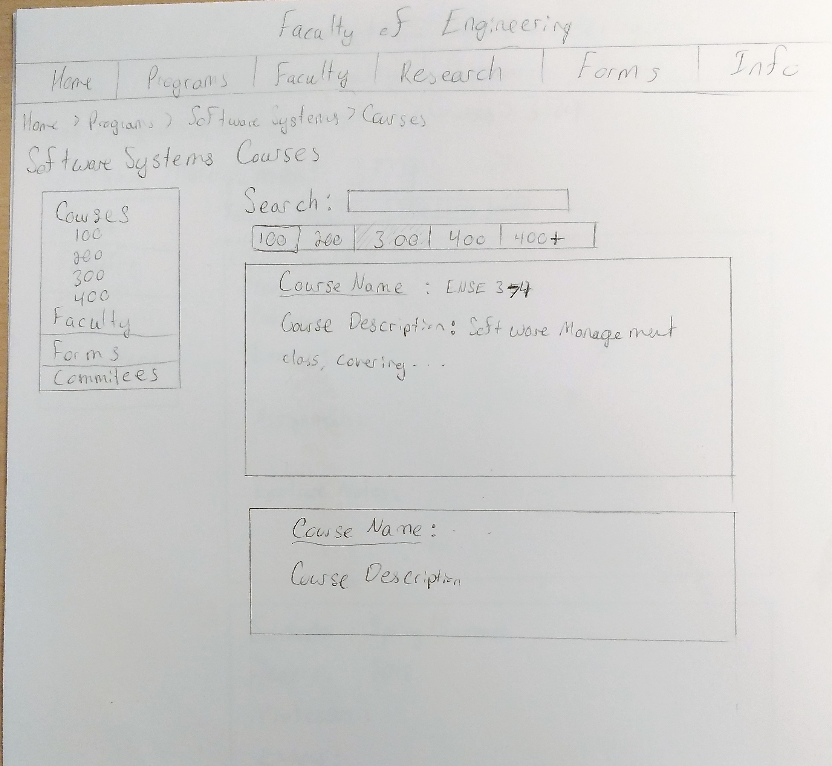
Programs
Content:
Courses:
Past Profs
Past Exams and Notes
Committees
Current and Past Members
Meeting Notes
Navigation:
Search via a search bar
Sort by Course number or Year
Notes:
Avery:
Content:
The key substance of the program pages are the courses and committees.
The courses contains all the courses and separated by Course level, they contain the course a brief overview.
The individual courses will contain the professor, Exams, assignments and lecture notes separated by year, with each year containing the individual semesters.
For Committees we separated it similarly to the courses, each committee is listed with members.
When the committee is selected, the committee is separated by year with members and meeting notes for the year.
Navigation:
Courses and Committees are currently navigated through a sidebar or a search function, we may implement drop downs for quicker access, generally the side bar gives some ease of navigation and a way to get to the main headings of programs easier.
Security: Past exam information and committees will be associated with the login and the assigned user and user/faculty groups.
Questions:
How easy was it to find the course from the past semester?
How was navigation to a committees meeting notes?

Slide 7
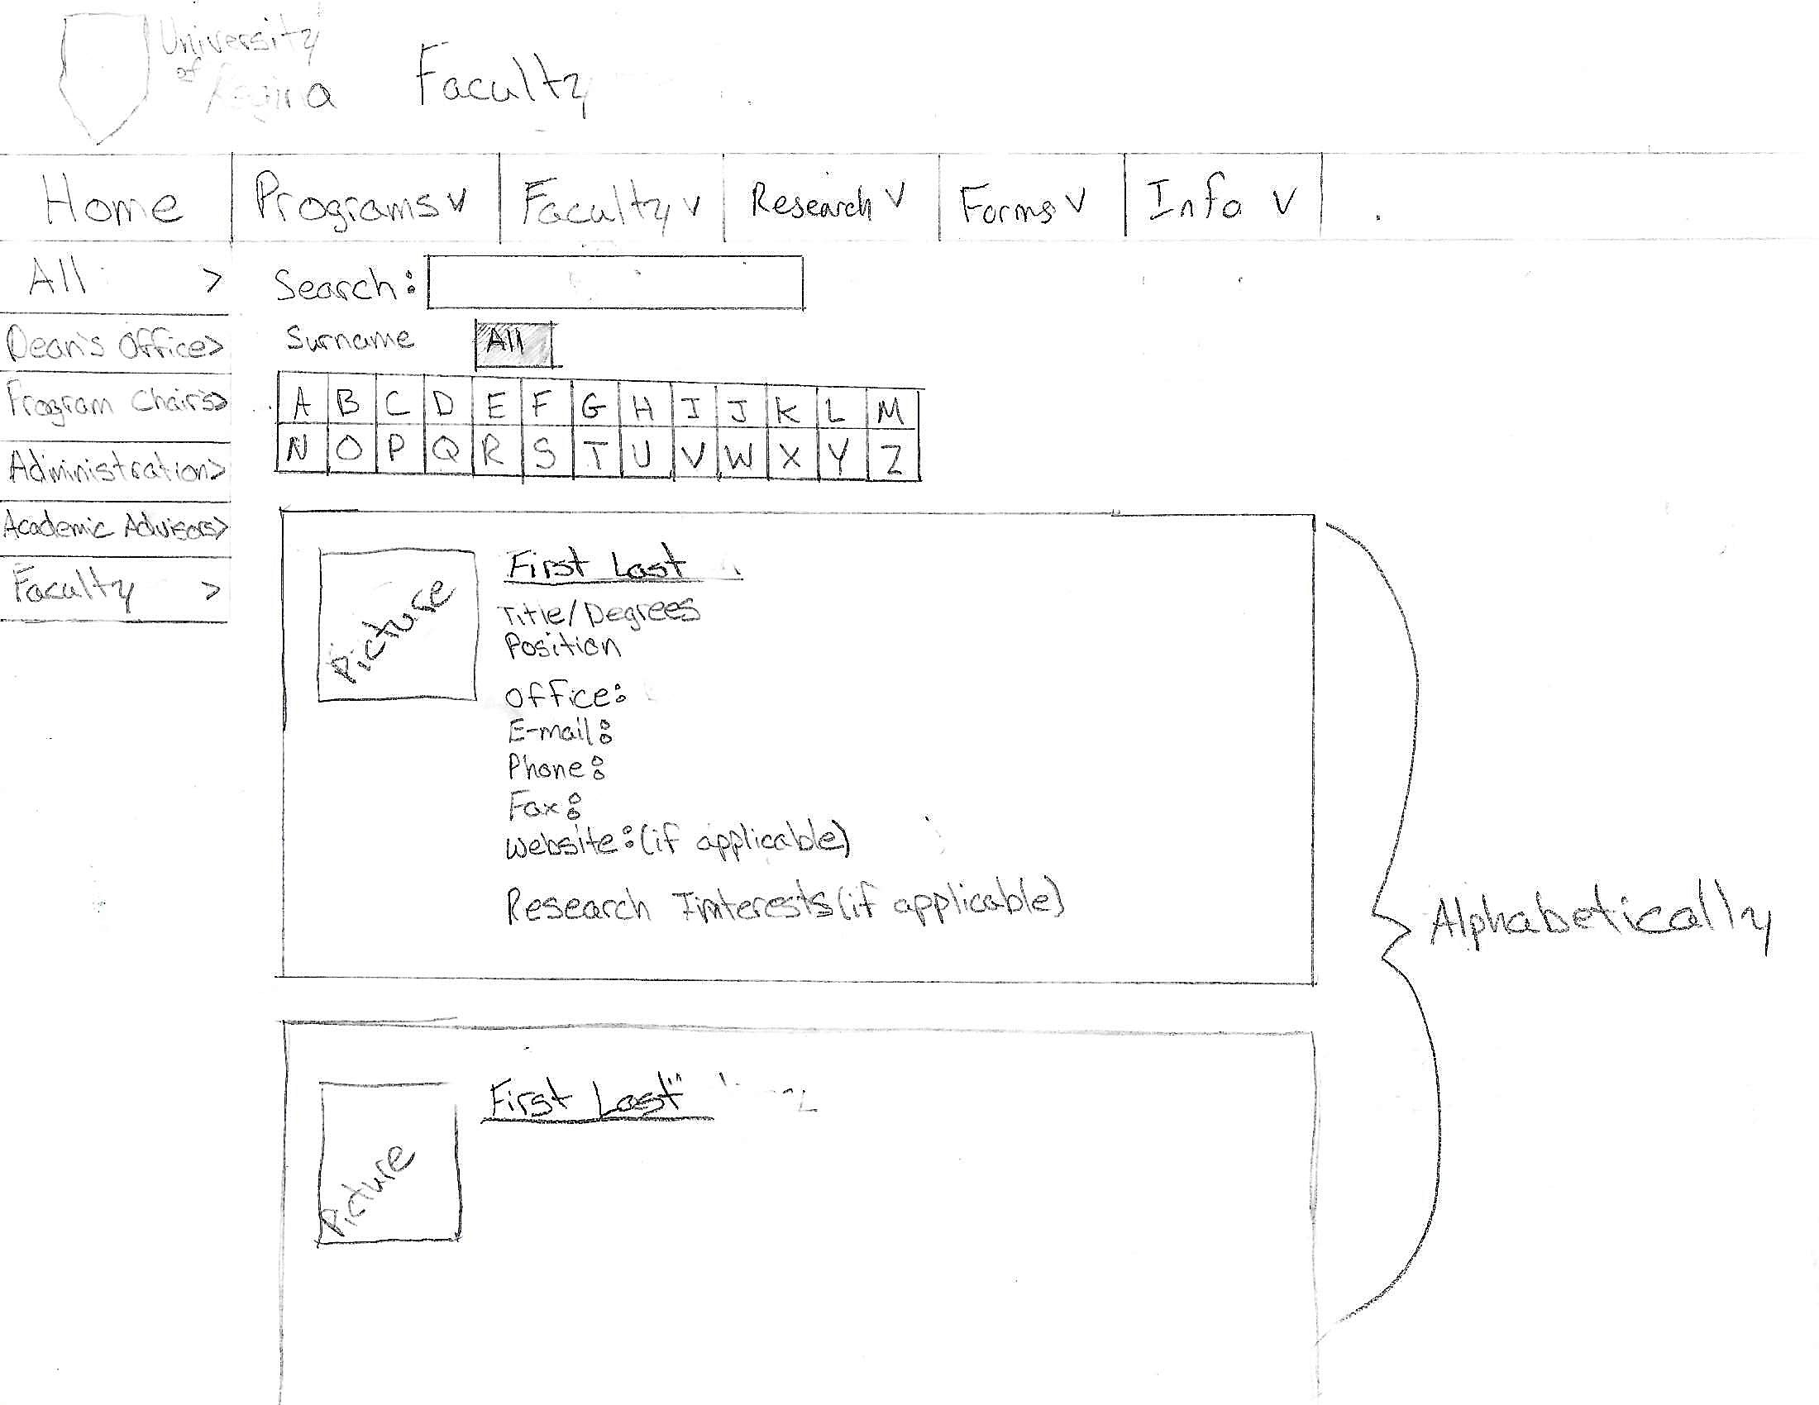
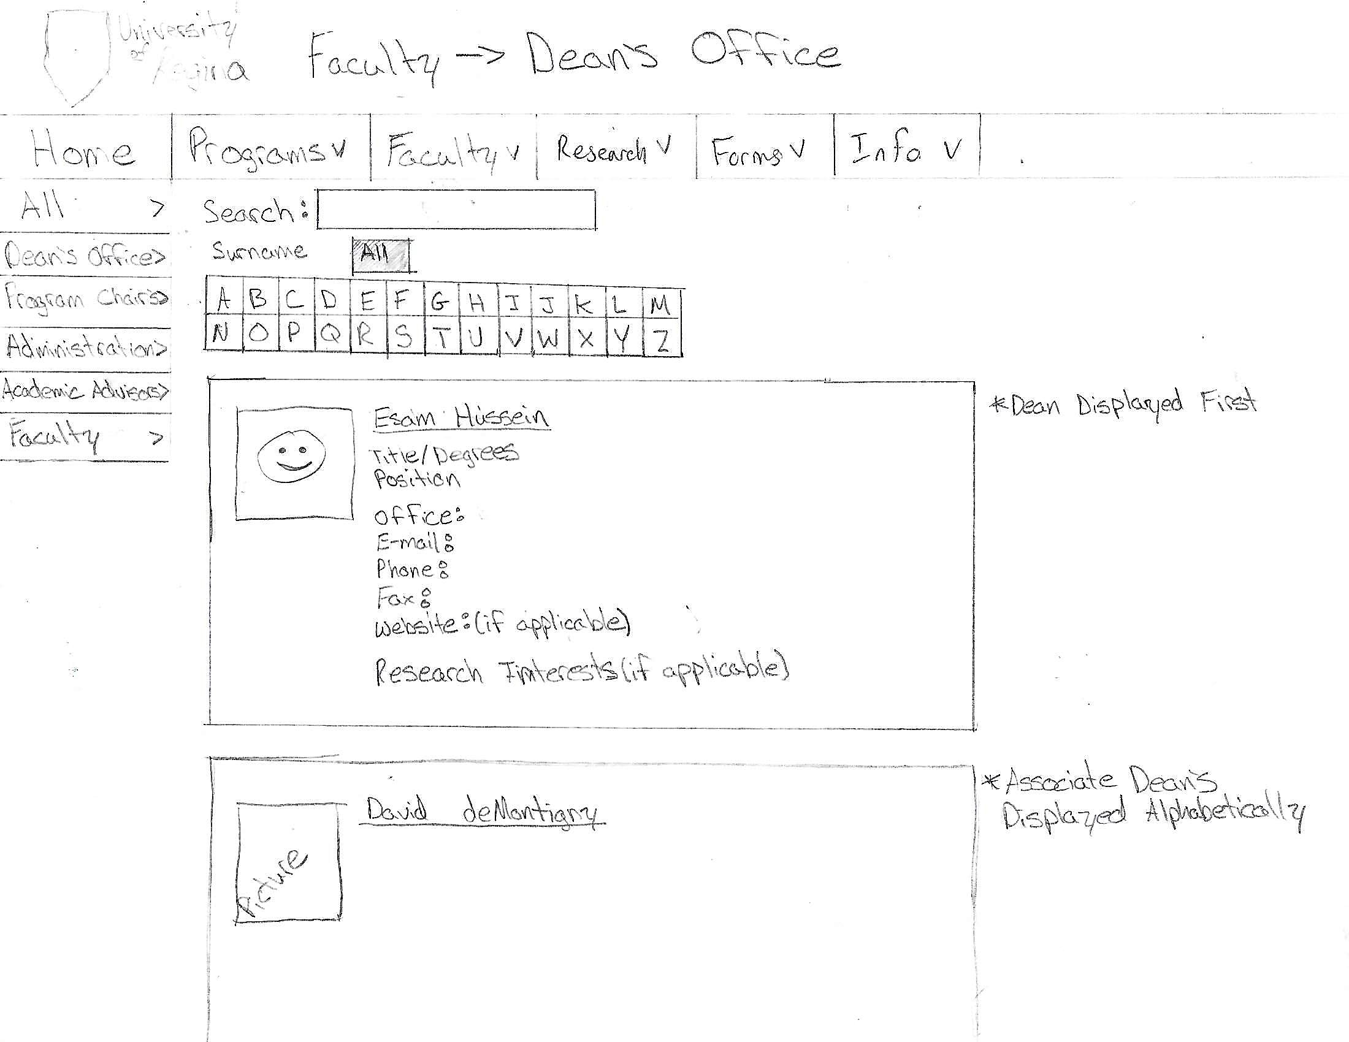
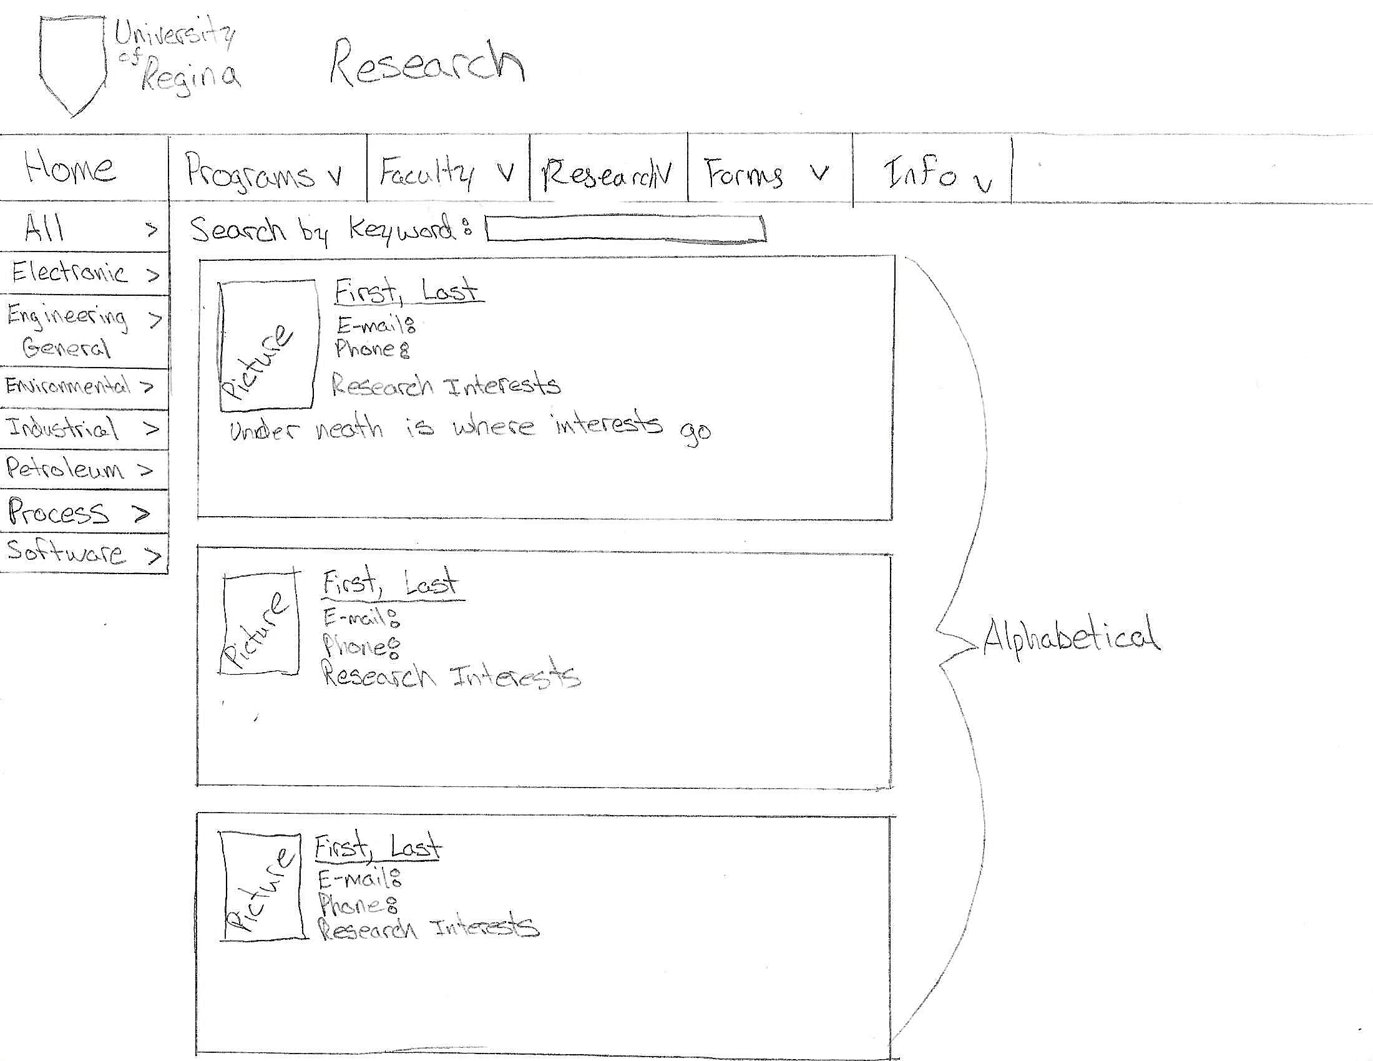
Faculty and Research
Content
Professors Details
Picture
General Information
Contact Information
Navigation
Alphabetical
Search by last name
Search bar
Structure
Research section only shows the people associated with research interest
Notes:
Mckenzie
Content:
The main content of the faculty page is each professors details. Each professor will have a picture, interests and contact information.
The content of research will be similar to faculty, just with research being identifying factor
Navigation:
The navigation is very simple. The list will start in alphabetical order and then the two fitler used to sort with a function for last name and a general search for the specific person.
Research will also be searchable by keyword to add to ease of finding information
Structure:
The big difference between faculty and research is research only shows people with research interests, allows a search by keyword (not just names), and just shows basic contact info
Note:
We may combine the Faculty and Research headings into one heading for clearer and less cluttered navigation bar.
Questions:
Faculty - How hard was it to find a specific professors?
Research - Could you find a specific professors research interest:

Slide 8
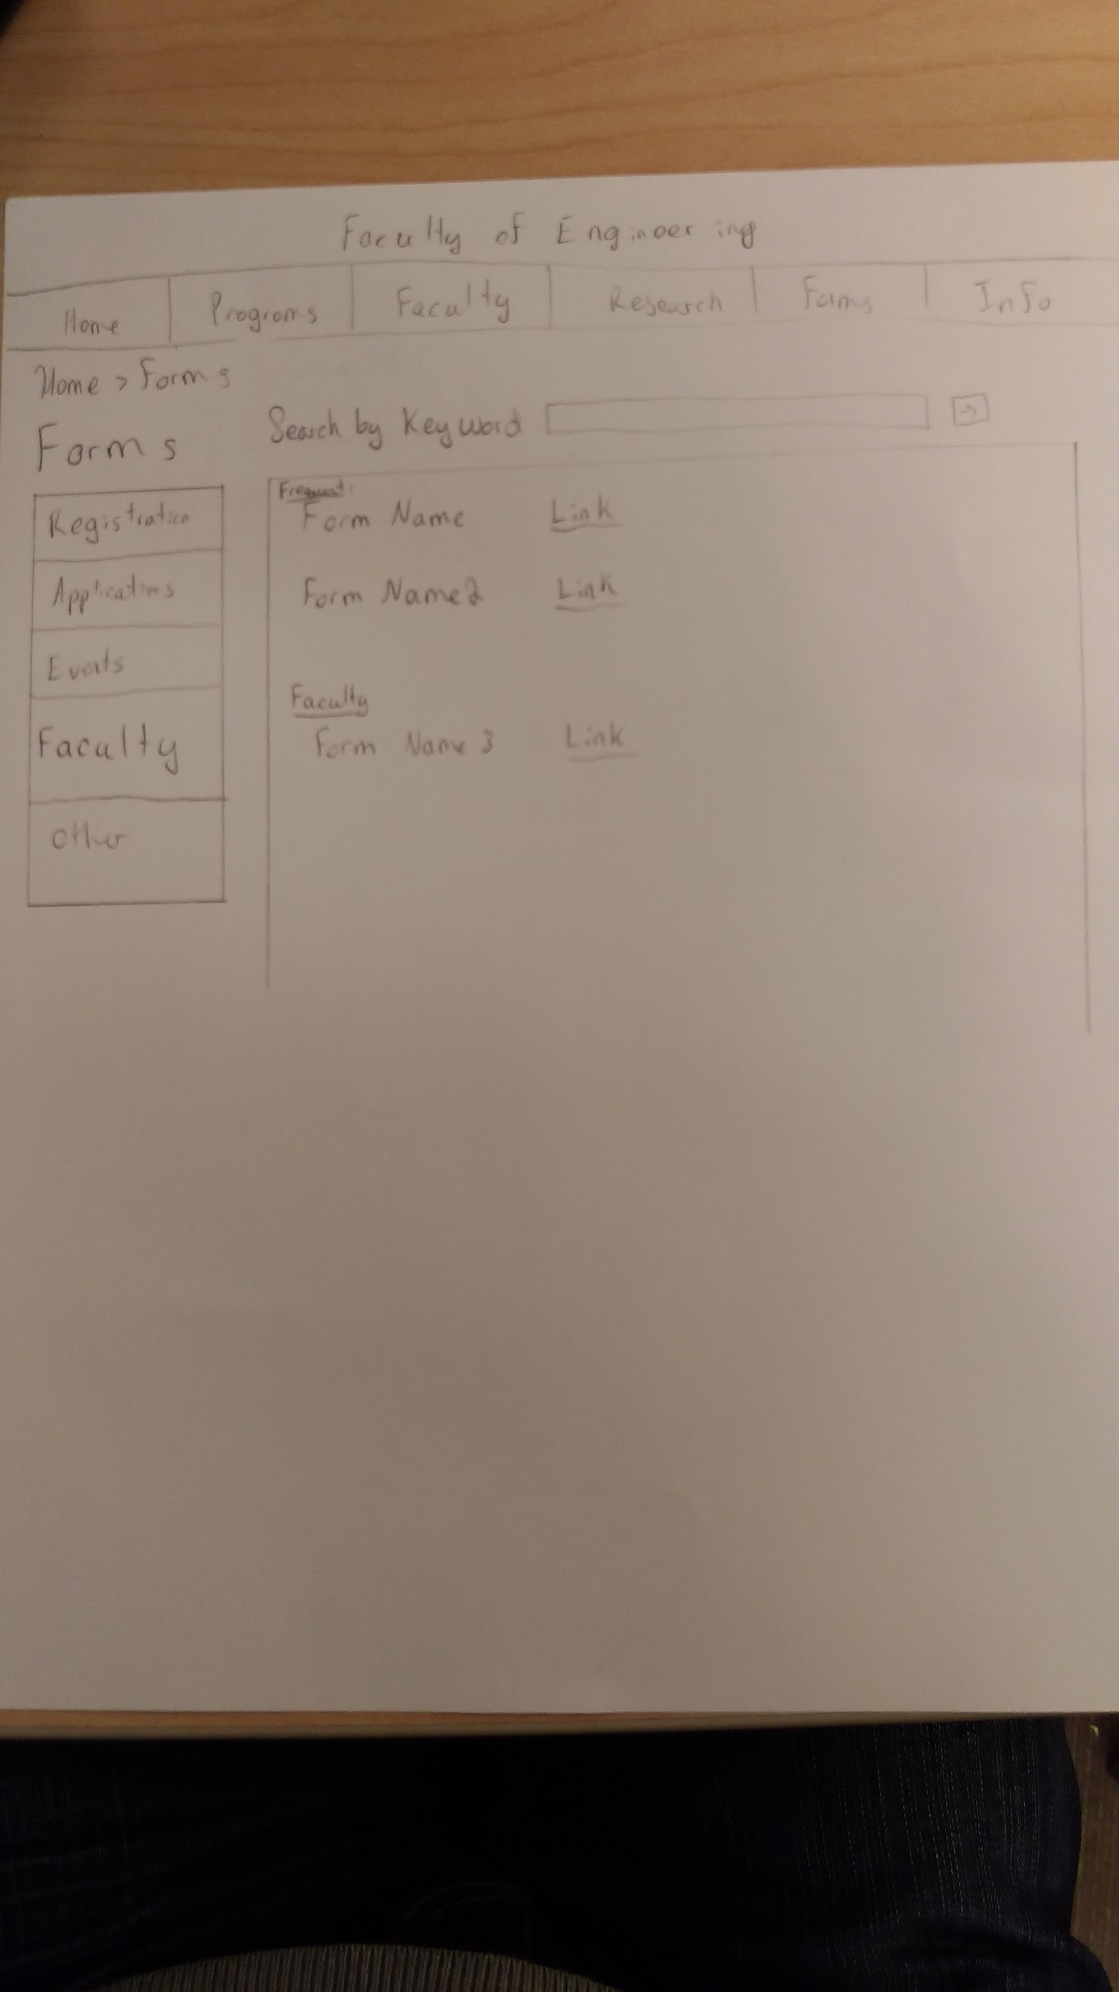
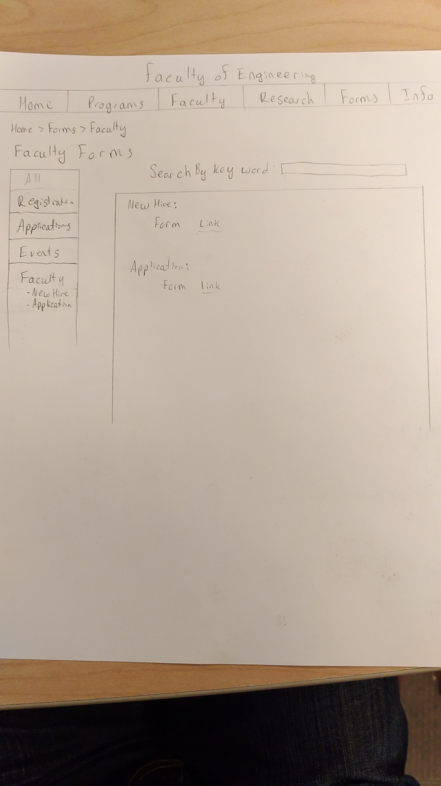
Forms
Content
Overview
-Frequent searches, main forms
-Each name of forms is given a link
Registration
Applications
Events
Faculty
-New hire forms
-Application forms
Other
Navigation
Forms will be searchable with consistency
Search by keyword
Main contents listed on side navigation
bar
Notes:
Jiahao
Content:
The forms page will contain the list of forms, able to be sorted be a category seen in the sidebar, or searched by keyword.
The forms will have a consistent naming convention similar to formName-date
Navigation & structure:
The forms will be searchable similar to courses, committees and faculty staying with the consistency planned for when we started
Questions:
How easy was it to find specific forms?

Slide 9
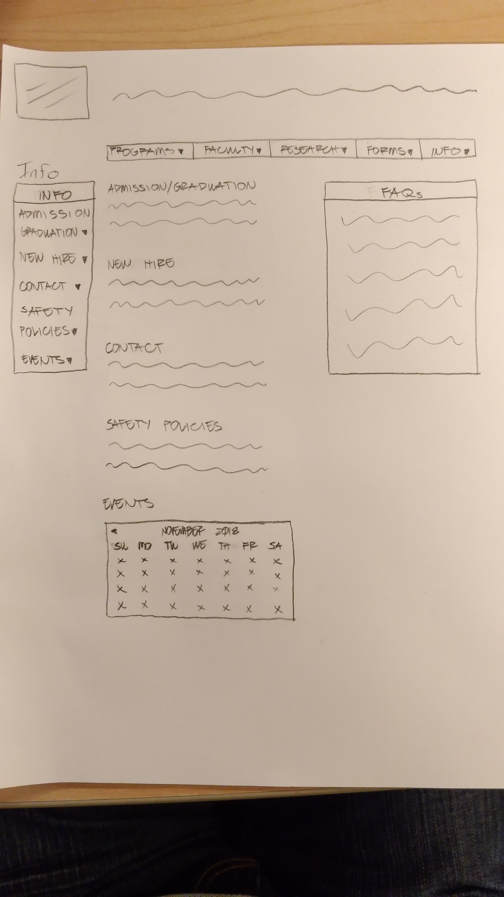
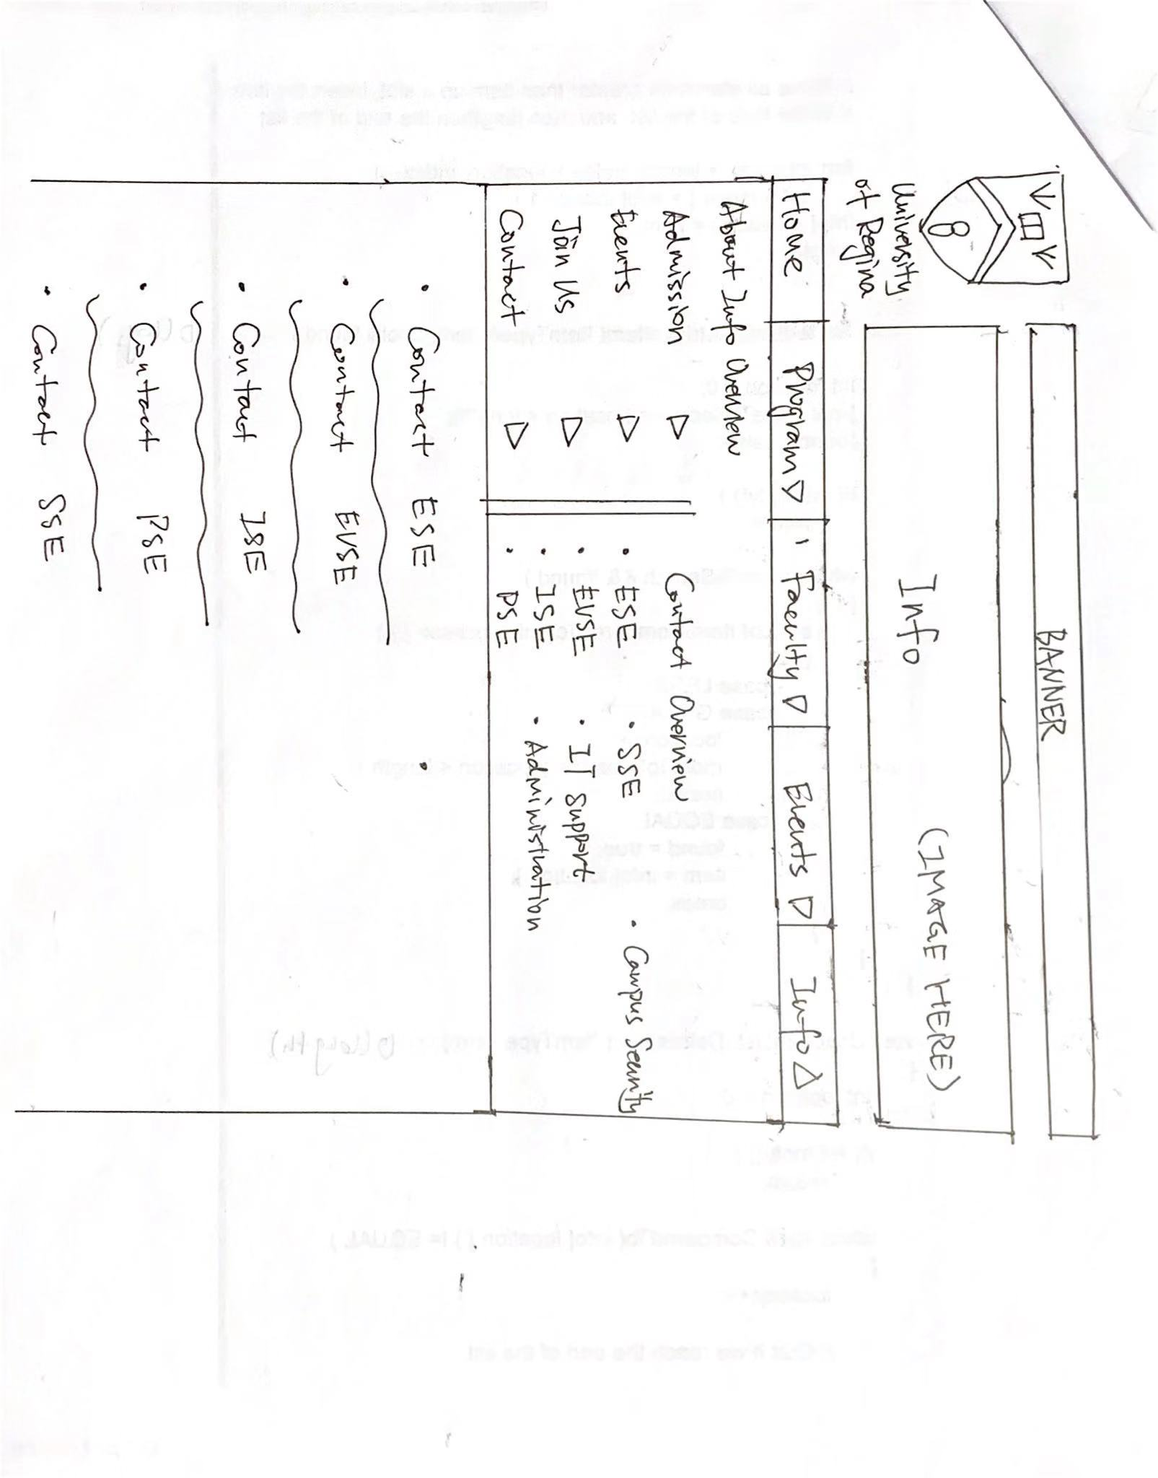
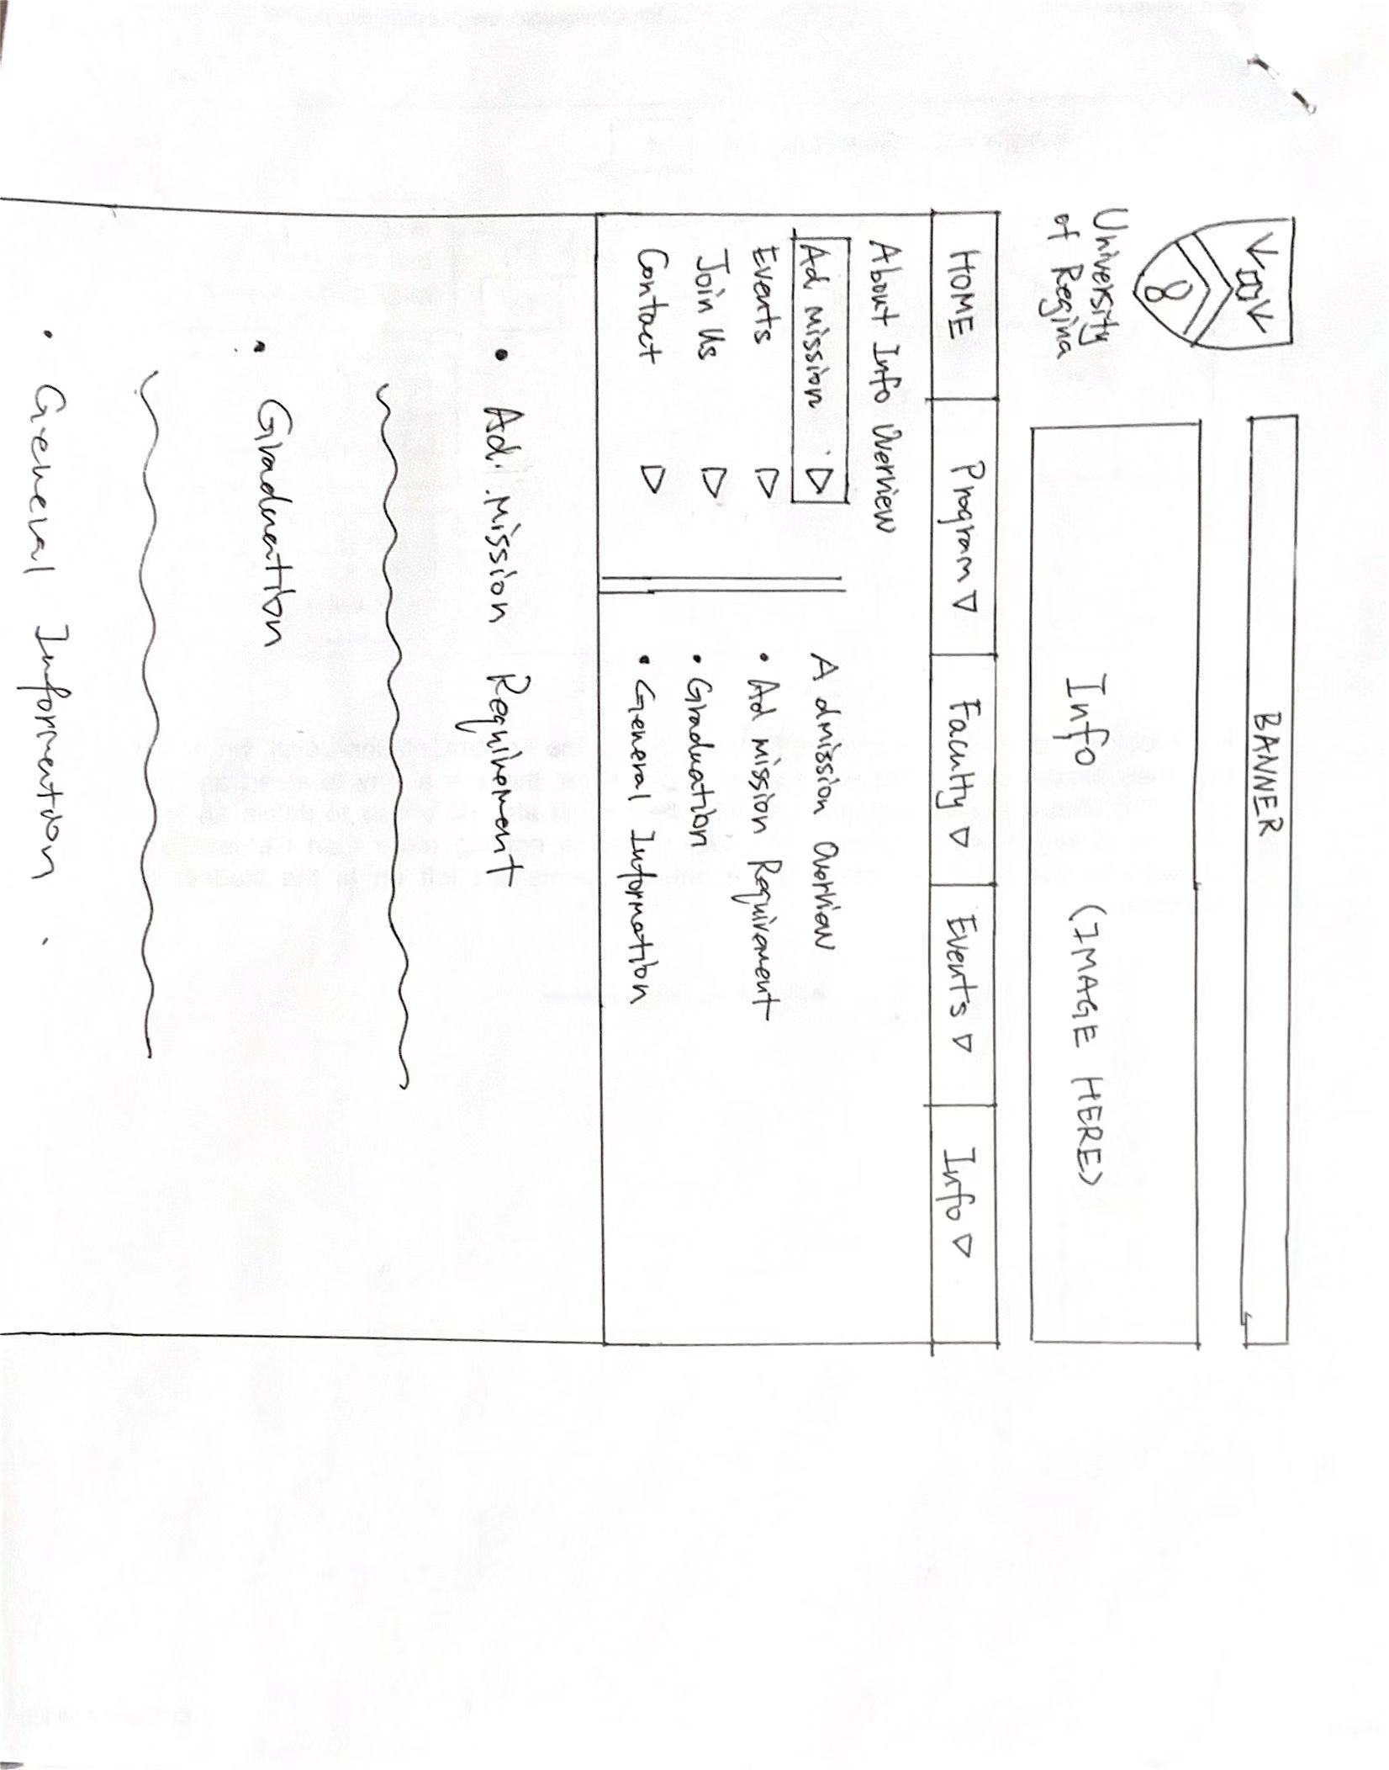
Info
Content
Overview
Admission
New Hire (Join Us)
Contact
Safety policies
Events
- Calendar for overview
- SubMenuContent sorted by date
Navigation
All contents centralized on one page
Search bar unnecessary
Some primary/latest information listed on main page
Structure
Main content
Simple navigation bar
FAQs
Notes:
Jinkai
Content:
The large prototype image Is our main page image we chose after individual sketching and brainstorming. The other images are potential secondary pages for contact info and admission info as you can see. This could change depending on the amount of information needing to be displayed.
The main categories of Info are, Admission information, New Hire, Contact Information, Safety Policies and Events
Navigation & structure:
Navigation will be simple with information kept to one central page, and with an easy to navigate sidebar. Structure will be consistent with the other pages without a search bar as it isn’t needed.
Calendar could be used for events overview, under the calendar there could be some primary and latest information showing for users.
Also FAQs could help users to find solutions whenever they have difficulties browsing the page, such as IT support stuff like that.
Questions:
Do you have difficulties to find the events in event section?
Does the main page showing all sections looks simple and clean?

Slide 10
Navigation Flow
Notes:
Avery:
Our navigation structure works with drop downs,
Software Systems can be reached from the home page and then to get to a specific course you would go to courses, select the course and click on the info you want.
This is an example of an interaction/task a user can have and other navigation tasks would have a similar set up.
We want to keep the flow simple and quick to ensure users get the info they need easily
Security within the navigation could be introduced as needed with the use of the cascade login page based on assigned groups.

Slide 11
Group reflection
How did you feel about this milestone? What did you like about it? What did you dislike?
The milestone was good, it felt like it is building upon the proposed content strategy from milestone 3 which was nice.
What did you learn about yourself as you collaborated and worked through this milestone?
Our group worked concurrently to accomplish milestone 4. This helped with an overall understanding for each group member.
How will you use what you have learned going forward?
Working as one unit helped with completing the milestone in an efficient timeframe.
What “stuff & things” related to this milestone would you want help with?
This milestone went very smoothly. Further assistance would not be required.
Notes:
Avery

Slide 12
Questions?

